Slide 1
Guide to Computer Forensics and Investigations Sixth Edition Chapter 13
Cloud Forensics
Notes:
Guide to Computer Forensics and Investigations Sixth Edition
Chapter 13
Cloud Forensics

Slide 2
Objectives
Describe the main concepts of cloud computing
Summarize the legal challenges in conducting cloud forensics
Give an overview of the technical challenges with cloud forensics
Describe how to acquire cloud data
Explain how to conduct a cloud investigation
Explain what remote access tools can be used for cloud investigations

Slide 3
An Overview of Cloud Computing
The cloud has introduced ways of managing data that didn’t exist a decade ago
Cloud investigations have unique challenges
New standards are being developed to improve security practices and incident responses in cloud environments

Slide 4
History of the Cloud (1 of 2)
Idea of cloud computing came from several people:
Professor John McCarthy of MIT
Dr. J.C.R. Licklider, director at the U.S. Department of Defense Advanced Research Projects Agency (ARPA)
In 1999, Salesforce.com developed a Web service that applied digital marketing research to business subscribers
This service led the way to the cloud

Slide 5
History of the Cloud (2 of 2)
Amazon created Amazon Mechanical Turk in 2002
Provided storage, computations, and human intelligence
Started Elastic Compute Cloud (EC2) in 2006, aimed at supporting small businesses
After Web 2.0 in 2009, other providers started their own cloud services
Google Apps, Apple iCloud, Microsoft OneDrive, and more

Slide 6
Cloud Service Levels and Deployment Methods (1 of 4)
The National Institute of Standards and Technology (NIST) defines cloud computing as:
A computing storage system that provides on-demand network access for multiple users and can allocate storage to users to keep up with changes in their needs

Slide 7
Cloud Service Levels and Deployment Methods (2 of 4)
The cloud has three service levels:
Software as a service (SaaS) - applications are delivered via the Internet
Platform as a service (PaaS) - an OS has been installed on a cloud server
Infrastructure as a service (IaaS) - customers can rent hardware and install whatever OSs and applications they need

Slide 8
Cloud Service Levels and Deployment Methods (3 of 4)
Table 13-1 | Locations of evidence in different service levels
Service level | Locations of evidence
SaaS | Most likely stored on a desktop, laptop, tablet, or smartphone.
PaaS | Most likely found on a desktop or server, although it could also be stored on a company network or the remote service provider’s infrastructure.
IaaS | Usually found on a desktop or server; infrastructure equipment can be owned by the company or the remote service provider.

Slide 9
Cloud Service Levels and Deployment Methods (4 of 4)
Deployment methods for a cloud:
Public - accessible to anyone
Private - can be accessed only by people who have the necessary credentials
Community - a way to bring people together for a specific purpose
Hybrid - enables a company to keep some information private and designate other files as public or community information

Slide 10
Cloud Vendors
Some cloud service providers (CSPs) and cloud applications:
Salesforce
IBM Cloud
Cisco Cloud Computing
Amazon EC2
AT&T Synaptic
Google Cloud Storage
HP Helion
Microsoft Azure
XenServer and XenCenter Windows Management Console
Rackspace
Oracle Cloud

Slide 11
Basic Concepts of Cloud Forensics (1 of 2)
Cloud forensics is considered a subset of network forensics
Cloud forensics can have three dimensions:
Organizational - addresses the structure of the cloud
Legal - covers service agreements and other jurisdictional matters
Technical - deals with procedures and specialized applications designed to perform forensics recovery and analysis in the cloud

Slide 12
Basic Concepts of Cloud Forensics (2 of 2)
Forensic tool capabilities needed to handle acquiring data from a cloud:
Forensic data collection - must be able to identify, label, record, and acquire data from the cloud
Elastic, static, and live forensics - must be able to expand and contract their storage capabilities
Evidence segregation - different businesses and users share the same applications and storage space
Investigations in virtualized environments - should have the capability to examine virtual systems

Slide 13
Legal Challenges in Cloud Forensics
When investigating a cloud system, consider factors involving a CSP’s relationship with cloud users
This section explains:
A CSP’s contract obligations with cloud users
How warrants and subpoenas are applied to CSPs and users

Slide 14
Service Level Agreements (1 of 5)
Cloud service agreements (CSAs) - a contract between a CSP and the customer that describes what services are being provided and at what level
Includes service legal agreements (SLAs)
CSAs should also specify:
Support options
Penalties for services not provided
System performance
Fees
Provided software or hardware

Slide 15
Service Level Agreements (2 of 5)
CSAs define the scope of services the CSP provides:
Service hours
Restrictions applied to the customer by the CSP
Availability of the cloud to the customer
Levels of support for the customer
Response time for data transfers
Throughput, limitations
Contingency plan for incident response
Business continuity and disaster recovery plan

Slide 16
Service Level Agreements (3 of 5)
CSAs define the scope of services the CSP provides (cont’d):
Fees for the subscription to the cloud and fees for additional services as they occur
Security measures
Terminology of the cloud’s systems and applications
CSP components must state who is authorized to access data and what the limitations are in conducting acquisitions for an investigation

Slide 17
Service Level Agreements (4 of 5)
Policies, Standards, and Guidelines for CSPs
Digital forensics should review CSPs policies, standards, and guidelines for daily operations
Policies - detailed rules for a CSP’s internal operation
Standards - give guidance to staff for unique operations, hardware, and software and describe the staff’s obligations regarding security of the CSP environment
Guidelines - describe best practices for cloud processes and give staff an example of what they should strive to achieve in their work

Slide 18
Service Level Agreements (5 of 5)
CSP Processes and Procedures - are detailed documents that define workflow and step-by-step instructions for CSP staff
Often include hardware configuration diagrams, network maps, and application processing flowcharts
Digital forensics examiners can use them to understand how data is stored, manipulated, secured, backed up, restored, and accessed by CSP staff and customers
Additional documents of interest:
CSP business continuity and disaster recovery plans

Slide 19
Jurisdiction Issues (1 of 2)
Although there are plans to revise current laws
Many cross-jurisdiction legal issues haven’t been resolved
No law ensures uniform access or required handling procedures for the cloud
Investigators should be concerned about cases involving data commingled with other customers’ data
Often, figuring out what law controls data stored in the cloud is a challenge

Slide 20
Jurisdiction Issues (2 of 2)
How privacy rights are defined in different jurisdictions is a major factor in problems with the right to access data
EU Directive 95/46/EC is more restrictive than rules in other countries, including the U.S.
Protects private information for all EU citizens
Digital forensics examiners could be held liable when conducting an investigation involving cloud data
Consult with legal experts to be aware of possible restrictions

Slide 21
Accessing Evidence in the Cloud (1 of 4)
The Electronic Communications Privacy Act (ECPA) describes five mechanisms the government can use to get electronic information from a provider:
Search warrants
Subpoenas
Subpoenas with prior notice to the subscriber or customer
Court orders
Court orders with prior notice to the subscriber or customer

Slide 22
Accessing Evidence in the Cloud (2 of 4)
Search Warrants
Can be used only in criminal cases and must be requested by a law enforcement officer who has evidence of probable cause that a crime was committed
Law requires search warrants to contain specific descriptions of what’s to be seized
For cloud environments, the property to be seized usually describes data rather than physical hardware, unless the CSP is the suspect

Slide 23
Accessing Evidence in the Cloud (3 of 4)
Search Warrants (cont’d)
Must also describe the location of items to be seized
Difficult when dealing with cloud data because servers are often dispersed across state or national borders
Must establish how it will be carried out
Specifying the date and time of day to minimize disruptions to people and business operations

Slide 24
Accessing Evidence in the Cloud (4 of 4)
Subpoenas and Court Orders
Government agency subpoenas - customer communications and records can’t be knowingly divulged to any person or entity
Used to get information when it’s believed there’s a danger of death or serious physical injury
Non-government and civil litigation subpoenas - used to produce information from private parties for litigation
Court orders - written by judges to compel someone to do or not do something

Slide 25
Technical Challenges in Cloud Forensics
Challenges in conducting cloud forensics
Architecture
Data collection
Analysis of cloud forensic data
Anti-forensics
Incident first responders
Role management
Legal issues
Standards and training

Slide 26
Architecture
No two CSPs are configured exactly the same way
Depending on the type of cloud architecture
Customer’s data could be commingled
Most CSPs keep data storage locations secret for security reasons
Differences in recording procedures or log keeping can make it difficult to determine data’s origin
And complicate an investigation’s chain of evidence

Slide 27
Analysis of Cloud Forensic Data
Analyzing digital evidence from a cloud requires verifying the data with other data and log records
Data may need to be reconstructed to determine what actually occurred during an incident
Examining logs can be useful to compare the modified, last access, and create (MAC) dates and times for files

Slide 28
Anti-Forensics (1 of 2)
Anti-forensics - destroying ESI that may be potential evidence
Hackers may use specialized malware for defeating evidence collection
Additional methods for anti-forensics:
Inserting malware programs in other files
Using encryption to obfuscate malware programs activated through other malware programs
Using data-hiding utilities that append malware to existing files

Slide 29
Anti-Forensics (2 of 2)
Other techniques affect file metadata by changing the modify and last access times
Changing timestamps can make it difficult to develop a timeline of a hacker’s activities
Calculating hash values of files and comparing the results with known good files’ hash values can help identify files that might have been altered

Slide 30
Incident First Responders (1 of 2)
CSPs have personnel trained to respond to network incidents
They become first responders when a network intrusion occurs
When CSPs do not have an internal first responder team, the forensics examiner should organize CSP staff to handle these tasks

Slide 31
Incident First Responders (2 of 2)
Some factors to address include:
Will the CSP’s operations staff be cooperative and follow directions, and will management issue orders stating that you’re the leader of the investigation?
Do you need to brief staff about operations security? For example, you might need to explain that they should talk only to others who have a need to know about the incident and the investigation’s activities
Do you need to train staff in evidence collection procedures, including the chain of custody?

Slide 32
Role Management
Role management in the cloud covers:
Data owners
Identity protection
Users
Access controls
As an investigator, you need to collect this information so you can identify additional victims or suspects

Slide 33
Standards and Training (1 of 2)
There is an effort to standardize cloud architectures for:
Operating procedures
Interoperability
Testing
Validation
The Cloud Security Alliance (CSA) has develop resource documentation for CSPs and their staff

Slide 34
Standards and Training (2 of 2)
Cloud investigators should have an understanding of cloud architecture
In addition to basic digital and network forensic skills
Sources for cloud forensics training:
(ISC)²’s Certified Cyber Forensics Professional
INFOSEC Institute
SANS Cloud Forensics with F-Response
National Institute of Justice Digital Forensics Training
University College Dublin Centre for Cybersecurity and Cybercrime Investigation

Slide 35
Acquisitions in the Cloud
Methods used to collect evidence in cloud investigations depend on the nature of the case
Recovering deleted data from cloud storage might be limited to the type of file system the CSP uses
With cloud systems running in a virtual environment, snapshots can give you valuable information before, during, and after an incident
Forensic examiners should re-create separate cloud servers from each snapshot, acquire an image of each server, and calculate a hash for all files

Slide 36
Encryption in the Cloud (1 of 3)
Many CSPs and third parties offer encryption services for cloud users as a security measure
Expect to find encrypted files in cloud investigations
You need assistance from the data owner or the CSP to decrypt data with the right encryption key
If data owner is uncooperative, you may need to turn to the attorneys handling the case or data owner’s management

Slide 37
Encryption in the Cloud (2 of 3)
Encrypted data in the cloud is in two states:
Data at rest - data that has been written to disk
Data in motion - data being transmitted over a network
Some system also have encryption for data in use (data that’s in RAM)
If encrypted data is encountered
Find out from the CSP what type of encryption was used and who knows how to recover it

Slide 38
Encryption in the Cloud (3 of 3)
Vendors that offer encryption services for cloud data:
Atalla Cloud Encryption from Micro Focus
SecureCloud from Trend Micro
SafeGuard Encryption and Sophos Mobile Control from Sophos
Homomorphic encryption
Uses an “ideal lattice” mathematical formula to encrypt data
Block chain technology
Used by companies such as Bitcoin, is a way to trace your information while keeping it secure

Slide 39
Conducting a Cloud Investigation
When investigating cloud incidents:
Use a systematic approach just like the one covered in Chapter 1
The type of incident determines how to proceed with planning the investigation
If the investigation involves searching for and recovering data from cloud storage or cloud customers
Follow methods described in Chapters 5 and 6

Slide 40
Investigating CSPs (1 of 2)
If a CSP has no team or limited staff, investigators should ask the following questions to understand how the CSP is set up:
Does the investigator have the authority to use cloud staff and resources to conduct an investigation?
Is detailed knowledge of the cloud’s topology, policies, data storage methods, and devices available?
Are there any restrictions on collecting digital evidence from remote cloud storage?

Slide 41
Investigating CSPs (2 of 2)
Investigators should ask the following questions to understand how the CSP is set up (cont’d):
For e-discovery demands on multitenant cloud systems, is the data to collect commingled with other cloud customers’ unrelated data? Is there a way to separate the data to prevent violating privacy rights or confidentiality agreements?
Is the data of interest to the investigation local or remote? If it’s in a remote location, can the CSP provide a forensically sound connection to it?

Slide 42
Investigating Cloud Customers
If a cloud customer doesn’t have the CSP’s application installed
You might find cloud-related evidence in a Web browser’s cache file
If the CSP’s application is installed
You can find evidence of file transfers in the application’s folder
Usually found under the user’s account folder

Slide 43
Understanding Prefetch Files (1 of 2)
Prefetch files - contain the DLL pathnames and metadata used by an application
The OS reads the associated prefetch file and loads its information into the computer’s memory
Speeds an application’s start time
The OS can handle other tasks instead of waiting for an application to load needed libraries
Example:
Metadata in a prefetch files contains an application’s MAC times in UTC format and a counter of how many times the app has run

Slide 44
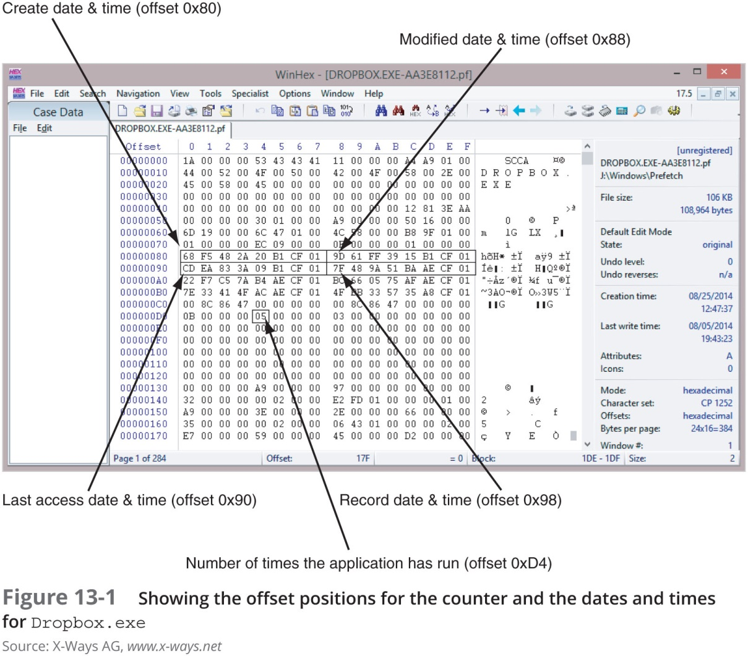
Understanding Prefetch Files (2 of 2)

Slide 45
Examining Stored Cloud Data on a PC (1 of 6)
Three widely used cloud services:
Dropbox
Google Drive
OneDrive
Services are free for storage up to 2 GB for Dropbox and up to 15 GB for Google Drive and OneDrive
These applications have Registry entries
Users must maintain control over access to their cloud accounts

Slide 46
Examining Stored Cloud Data on a PC (2 of 6)
Dropbox offers third-party applications, such as e-mail, chat, Cisco WebEx, and other collaboration tools
Since 2012, Dropbox has used base-64 format to store content
Reading them requires specialized software
Magnet Forensics has a tool called Internet Evidence Finder (IEF) designed for this purpose

Slide 47
Examining Stored Cloud Data on a PC (3 of 6)
Gmail users have access to Google Drive for cloud data storage and applications
Google Drive is installed in:
C:\Program Files (x86)\Google\Drive
Each user has a configuration file stored in C:\Users\username\AppData\Local\Google\Drive
Called a “user profile”
If Google Drive has been installed, it creates a folder in the path C:\Users\username\Google Drive

Slide 48
Examining Stored Cloud Data on a PC (4 of 6)
Important Google Drive files:
sync_config.db - an SQL database file with Google Drive upgrade number, highest application version number, and local synchronization root path
snapshot.db - contains information about each file accessed, the URL pathname, the modified and created dates and times in UNIX timestamp format, and the file’s MD5 value and size
sync_log.log - has a detailed list of a user’s cloud transactions

Slide 49
Examining Stored Cloud Data on a PC (5 of 6)
OneDrive - created by Microsoft and was originally called SkyDrive
Available with Windows 8 and later
Similar to DropBox and Google Drive and offers subscription services for Microsoft software
OneDrive stores user profiles in the user’s account path
Log files and synchronized files are kept in various places under the user’s account (depending on the Windows version)

Slide 50
Examining Stored Cloud Data on a PC (6 of 6)
You can find more information in the following Windows 8.1 log files, which are in the C:\Users\username\AppData\Local\Microsoft\Windows\SkyDrive\logs folder
SyncEngine-yyyy-mm-ddnn.nnn-n.et1 manages synchronization between OneDrive and a user’s computer
SyncDiagnostics.log contains client ID, clientType, clientVersion, device, deviceID, and timeUtc values

Slide 51
Windows Prefetch Artifacts
You can collect prefetch file artifacts with a disk editor or forensics tool
Follow the steps in the activity starting on page 546 to use WinHex’s Data Interpreter to find an application’s MAC dates and times
And the number of times DropBox has run

Slide 52
Tools for Cloud Forensics
Few tools designed for cloud forensics were available
Many digital, network, and e-discovery tools can be combined to collect and analyze cloud data
Some vendor with integrated tools:
Guidance Software EnCase eDiscovery
AccessData Digital Forensics Incident Response
F-Response

Slide 53
Forensic Open-Stack Tools (1 of 2)
Forensic Open-Stack Tools (FROST) integrates with OpenStack running in IaaS cloud environments
Adds forensics response capabilities for a CSP
OpenStack - an open-source computing platform intended for public and private cloud services
FROST is the first known effort to provide a forensics response process for a cloud service

Slide 54
Forensic Open-Stack Tools (2 of 2)
A feature of FROST
It bypasses a VMs hypervisor
Collected data is placed in the cloud’s management plane, which is a tool with application programming interfaces that allow reconfiguring the cloud on the fly
Special malware can take control of the virtual session and deny or alter access
Can also prevent or interfere with forensic analysis and data collection

Slide 55
F-Response for the Cloud
F-Response is a remote access tool that can be applied to cloud forensics
Uses USB forwarding techniques to allow non-remote-capable forensics tools to access remote servers and their data storage
Two tools are needed:
F-Response Enterprise or Consultant
KernelPro USB-Over-Ethernet

Slide 56
Magnet AXIOM Cloud
Magnet AXIOM created a Cloud module to go with its Process and Examine modules
Magnet AXIOM Cloud
Retrieves information from Facebook Messenger, Skype, Instagram, Twitter, iCloud, and others
You still need usernames and passwords

Slide 57
Summary (1 of 4)
Three service levels are available for the cloud: software as a service, platform as a service, and infrastructure as a service
CSPs use servers on distributive networks or mainframes that allow elasticity of resources for customers
With multinational clouds, you should seek legal counsel before proceeding with an investigation
Cloud investigations are necessary in cases involving cyberattacks, policy violations, data recovery, and fraud complaints

Slide 58
Summary (2 of 4)
Before initiating a cloud investigations, review the CSA to identify any restrictions that might limit collecting and analyzing data
Technical challenges in cloud forensics involve cloud architecture, data collection, analysis of cloud forensic data, anti-forensics, incident first responders, role management, legal issues, and standards and training
Anti-forensics is an effort to alter log records as well as date and time values of important system files and install malware to hide hacker’s activities

Slide 59
Summary (3 of 4)
CSPs should have an incident response team ready to respond to network intrusions
Role management defines the duties of CSP staff and customers
The Cloud Security Alliance has developed resources that guide CSPs in privacy agreements and security measures
Procedures for acquiring cloud evidence include examining network and firewall logs, performing disk acquisitions of a cloud system’s OS, and examining data storage devices

Slide 60
Summary (4 of 4)
When investigating a cloud incident, apply a systematic approach to planning and processing the case
The three cloud services Dropbox, Google Drive, and Microsoft OneDrive contain data on a user’s computer or mobile device that can reveal what files were copied or accessed
Vendors offer tools that can be combined for cloud forensics

